Slide 1
DNA Operations
Dr. Muhammad Tahir
Assistant Professor
COMSATS University Islamabad,
Attock Campus

Slide 2
Outline
Copying DNA
Polymerase Chain Reaction
Cloning
Cutting and Pasting DNA
Restriction Enzymes
Measuring DNA Length
Electrophoresis
DNA sequencing
Probing DNA
DNA probes
DNA arrays

Slide 3
Analyzing a Genome
To analyze a genome in four easy steps.
Cut it
Use enzymes to cut the DNA into small fragments.
Copy it
Copy it many times to make it easier to see and detect.
Read it
Use special chemical techniques to read the small fragments.
Assemble it
Take all the fragments and put them back together. This is hard!!!
Bioinformatics takes over
What can we learn from the sequenced DNA.
Compare interspecies and intraspecies.

Slide 4
Copying DNA
An Introduction to Bioinformatics Algorithms
www.bioalgorithms.info

Slide 5
Why we need so many copies
Biologists needed to find a way to read DNA codes.
How do you read base pairs that are angstroms in size?
It is not possible to directly look at it due to DNA’s small size.
Need to use chemical techniques to detect what you are looking for.
To read something so small, you need a lot of it, so that you can actually detect the chemistry.
Need a way to make many copies of the base pairs, and a method for reading the pairs.
Angstrom: A metric unit of length equal to one ten billionth of a meter (or 0.0001 micron); used to specify wavelengths of electromagnetic radiation
Notes:
Angstrom: A metric unit of length equal to one ten billionth of a meter (or 0.0001 micron); used to specify wavelengths of electromagnetic radiation

Slide 6
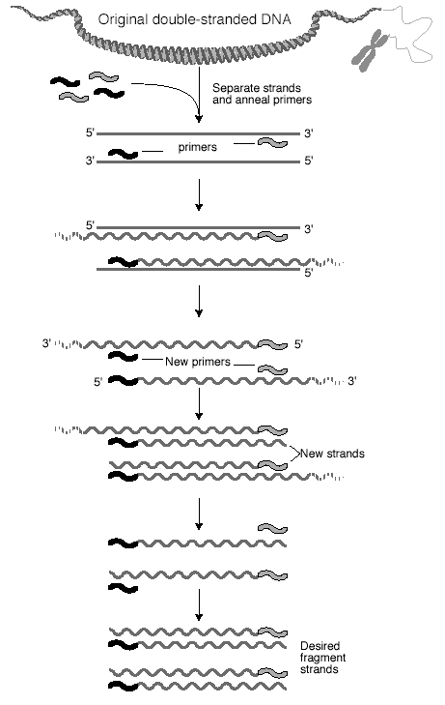
Polymerase Chain Reaction (PCR)
Polymerase Chain Reaction (PCR)
Used to massively replicate DNA sequences.
How it works:
Separate the two strands with low heat
Add some base pairs, primer sequences, and DNA Polymerase
Creates double stranded DNA from a single strand.
Primer sequences create a seed from which double stranded DNA grows.
Now you have two copies.
Repeat. Amount of DNA grows exponentially.
1→2→4→8→16→32→64→128→256…

Slide 7
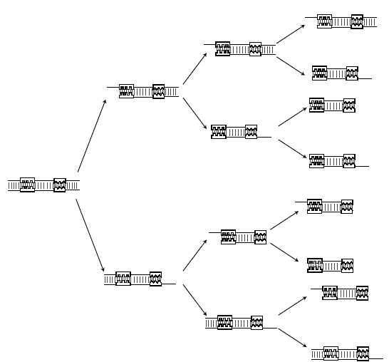
Polymerase Chain Reaction
Problem: Modern instrumentation cannot easily detect single molecules of DNA, making amplification a prerequisite for further analysis
Solution: PCR doubles the number of DNA fragments at every iteration
1… 2… 4… 8…

Slide 8
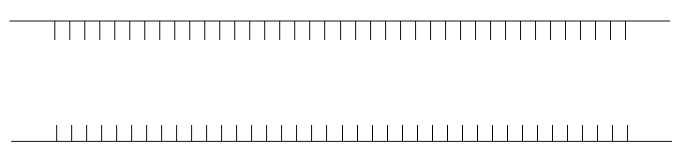
Denaturation
Raise temperature to 94ºC to separate the duplex form of DNA into single strands

Slide 9
Design primers
To perform PCR, a 10-20bp sequence on either side of the sequence to be amplified must be known because DNA pol requires a primer to synthesize a new strand of DNA

Slide 10

Annealing
Anneal primers at 50-65ºC

Slide 11
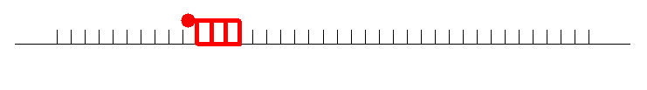
Annealing
Anneal primers at 50-65ºC

Slide 12
Extension
Extend primers: raise temp to 72ºC, allowing Taq polymerase to attach at each priming site and extend a new DNA strand
Taq polymerase is an enzyme that copies DNA. It is isolated from a heat-loving bacterium that is naturally found in hot springs, so the enzyme doesn't break down at the high temperatures necessary for copying DNA using a polymerase chain reaction
Notes:
Taq polymerase is an enzyme that copies DNA. It is isolated from a heat-loving bacterium that is naturally found in hot springs, so the enzyme doesn't break down at the high temperatures necessary for copying DNA using a polymerase chain reaction

Slide 13
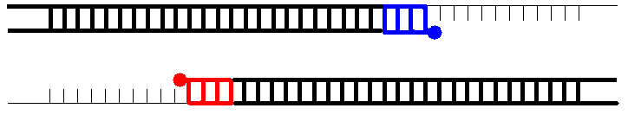
Extension
Extend primers: raise temp to 72ºC, allowing Taq pol to attach at each priming site and extend a new DNA strand

Slide 14
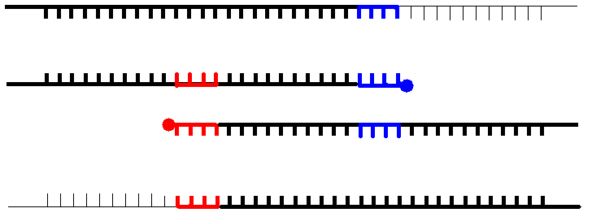
Repeat
Repeat the Denature, Anneal, Extension steps at their respective temperatures…

Slide 15
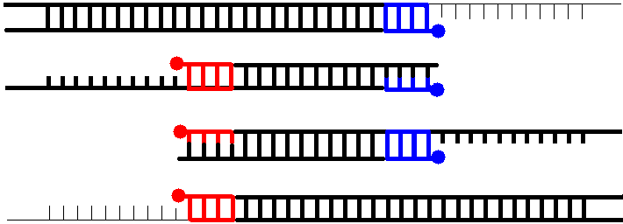
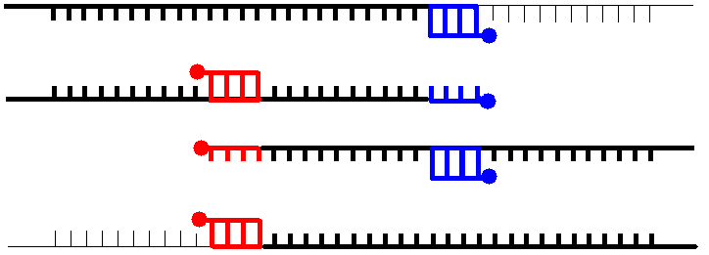
Polymerase Chain Reaction

Slide 16
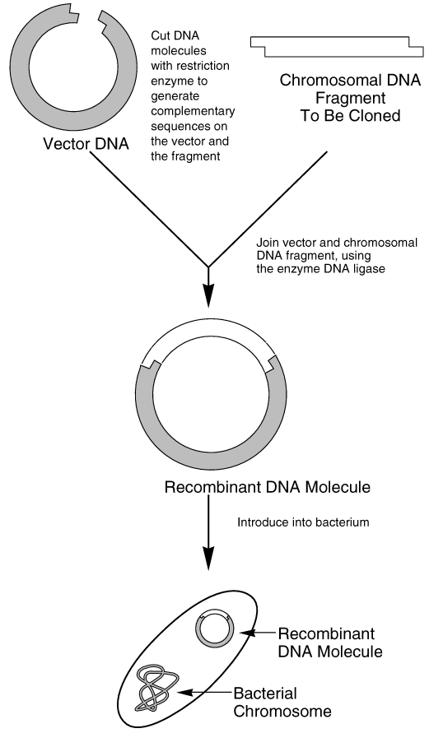
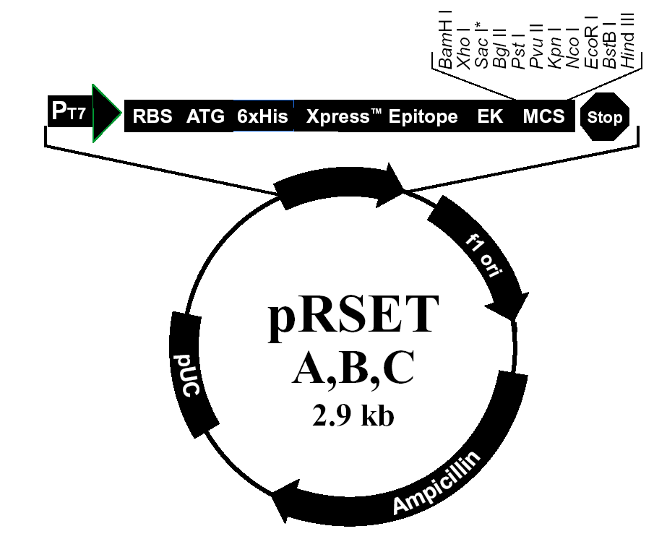
Cloning DNA
DNA Cloning
Insert the fragment into the genome of a living organism and watch it multiply.
Once you have enough, remove the organism, keep the DNA.
Use Polymerase Chain Reaction (PCR)
Vector DNA

Slide 17
2. Cutting and Pasting DNA
An Introduction to Bioinformatics Algorithms
www.bioalgorithms.info

Slide 18
Restriction Enzymes
Discovered in the early 1970’s
Used as a defense mechanism by bacteria to break down the DNA of attacking viruses.
They cut the DNA into small fragments.
Can also be used to cut the DNA of organisms.
This allows the DNA sequence to be in a more manageable bite-size pieces.
It is then possible using standard purification techniques to single out certain fragments and duplicate them to macroscopic quantities.

Slide 19
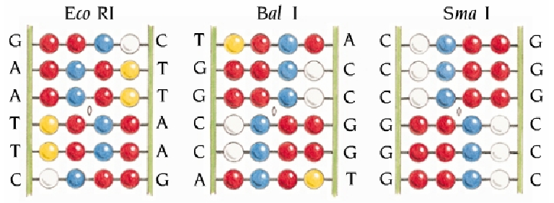
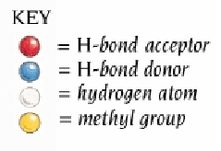
Cutting DNA
Restriction Enzymes cut DNA
Only cut at special sequences
DNA contains thousands of these sites.
Applying different Restriction Enzymes creates fragments of varying size.
Restriction Enzyme “A” Cutting Sites
Restriction Enzyme “B” Cutting Sites
“A” and “B” fragments overlap
Restriction Enzyme “A” & Restriction Enzyme “B” Cutting Sites
Visit: https://www.takarabio.com/products/cloning/restriction-enzymes

Slide 20
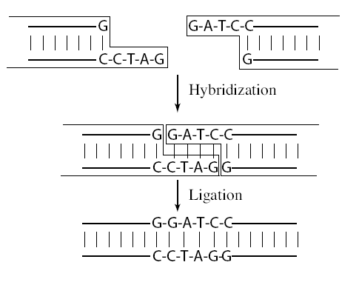
Pasting DNA
Two pieces of DNA can be fused together by adding chemical bonds
Hybridization – complementary base-pairing
Ligation – fixing bonds with single strands

Slide 21
3. Measuring DNA Length
An Introduction to Bioinformatics Algorithms
www.bioalgorithms.info

Slide 22
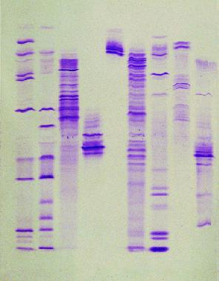
Electrophoresis
A co-polymer of mannose and galactose, agaraose, when melted and re-cooled, forms a gel with pores sizes dependent upon the concentration of agarose
The phosphate backbone of DNA is highly negatively charged, therefore DNA will migrate in an electric field
The size of DNA fragments can then be determined by comparing their migration in the gel to known size standards.

Slide 23
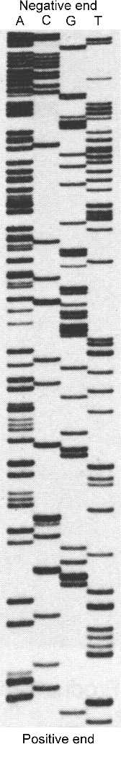
Reading DNA
Electrophoresis
Reading is done mostly by using this technique. This is based on separation of molecules by their size (and in 2D gel by size and charge).
DNA or RNA molecules are charged in aqueous solution and move to a definite direction by the action of an electric field.
The DNA molecules are either labeled with radioisotopes or tagged with fluorescent dyes. In the latter, a laser beam can trace the dyes and send information to a computer.
Given a DNA molecule it is then possible to obtain all fragments from it that end in either A, or T, or G, or C and these can be sorted in a gel experiment.
Another route to sequencing is direct sequencing using gene chips.

Slide 24
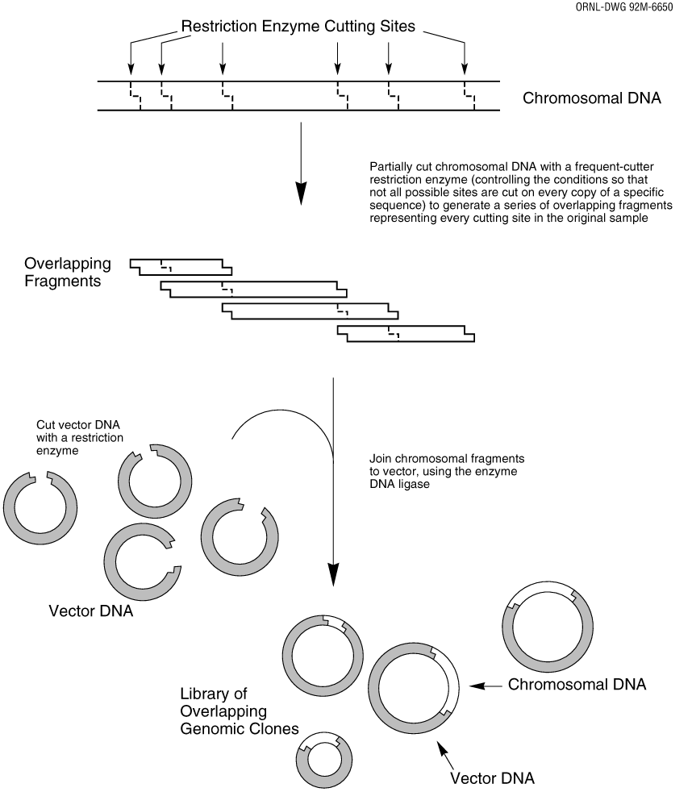
Assembling Genomes
Must take the fragments and put them back together
Not as easy as it sounds.
SCS Problem (Shortest Common Superstring)
Some of the fragments will overlap
Fit overlapping sequences together to get the shortest possible sequence that includes all fragment sequences

Slide 25
Assembling Genomes
DNA fragments contain sequencing errors
Two complements of DNA
Need to take into account both directions of DNA
Repeat problem
50% of human DNA is just repeats
If you have repeating DNA, how do you know where it goes?

Slide 26
4. Probing DNA
An Introduction to Bioinformatics Algorithms
www.bioalgorithms.info
‹#›
Notes:
Probing means Examining

Slide 27
DNA probes
An Introduction to Bioinformatics Algorithms
www.bioalgorithms.info
Oligonucleotides: single-stranded DNA 20-30 nucleotides long
Oligonucleotides used to find complementary DNA segments.
Made by working backwards---AA sequence----mRNA---cDNA.
Made with automated DNA synthesizers and tagged with a radioactive isotope.
‹#›

Slide 28
DNA Hybridization
An Introduction to Bioinformatics Algorithms
www.bioalgorithms.info
Single-stranded DNA will naturally bind to complementary strands.
Hybridization is used to locate genes, regulate gene expression, and determine the degree of similarity between DNA from different sources.
Hybridization is also referred to as annealing or renaturation.
‹#›

Slide 29
Create a Hybridization Reaction
An Introduction to Bioinformatics Algorithms
www.bioalgorithms.info
1. Hybridization is binding two genetic sequences. The binding occurs because of the hydrogen bonds [pink] between base pairs.
2. When using hybridization, DNA must first be denatured, usually by using use heat or chemical.
T
C
T
A
G
C
G
T
C
A
T
G
T
TAGGC
T
ATCCGACAATGACGCC
http://www.biology.washington.edu/fingerprint/radi.html
‹#›

Slide 30
Create a Hybridization Reaction Cont.
An Introduction to Bioinformatics Algorithms
www.bioalgorithms.info
3. Once DNA has been denatured, a single-stranded radioactive probe [light blue] can be used to see if the denatured DNA contains a sequence complementary to probe.
4. Sequences of varying homology stick to the DNA even if the fit is poor.
ACTGC
ACTGC
ATCCGACAATGACGCC
Great Homology
ACTGC
ATCCGACAATGACGCC
Less Homology
ATTCC
ATCCGACAATGACGCC
Low Homology
ACCCC
ATCCGACAATGACGCC
http://www.biology.washington.edu/fingerprint/radi.html
‹#›

Slide 31
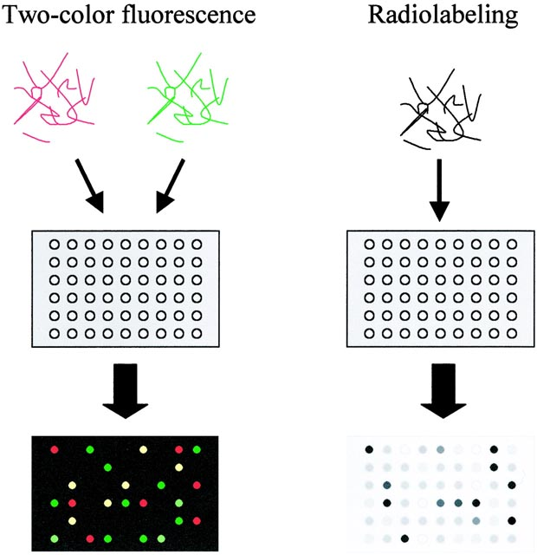
Labeling technique for DNA arrays
An Introduction to Bioinformatics Algorithms
www.bioalgorithms.info
RNA samples are labeled using fluorescent nucleotides (left) or radioactive nucleotides (right), and hybridized to arrays. For fluorescent labeling, two or more samples labeled with differently colored fluorescent markers are hybridized to an array. Level of RNA for each gene in the sample is measured as intensity of fluorescence or radioactivity binding to the specific spot. With fluorescence labeling, relative levels of expressed genes in two samples can be directly compared with a single array.
http://www.nature.com/cgi-taf/DynaPage.taf.html
6

Slide 32
DNA Arrays--Technical Foundations
An Introduction to Bioinformatics Algorithms
www.bioalgorithms.info
An array works by exploiting the ability of a given mRNA molecule to hybridize to the DNA template.
Using an array containing many DNA samples in an experiment, the expression levels of hundreds or thousands genes within a cell by measuring the amount of mRNA bound to each site on the array.
With the aid of a computer, the amount of mRNA bound to the spots on the microarray is precisely measured, generating a profile of gene expression in the cell.
http://www.ncbi.nih.gov/About/primer/microarrays.html
‹#›

Slide 33
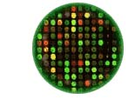
An experiment on a microarray
In this schematic: GREEN represents Control DNA
RED represents Sample DNA
YELLOW represents a combination of Control and Sample DNA
BLACK represents areas where neither the Control nor Sample DNA
Each color in an array represents either healthy (control) or diseased (sample) tissue.
The location and intensity of a color tell us whether the gene, or mutation, is present in
the control and/or sample DNA.
http://www.ncbi.nih.gov/About/primer/microarrays.html
10

Slide 34
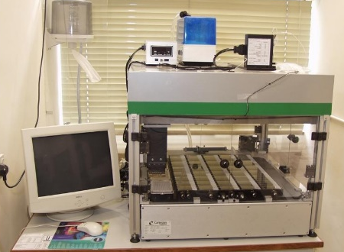
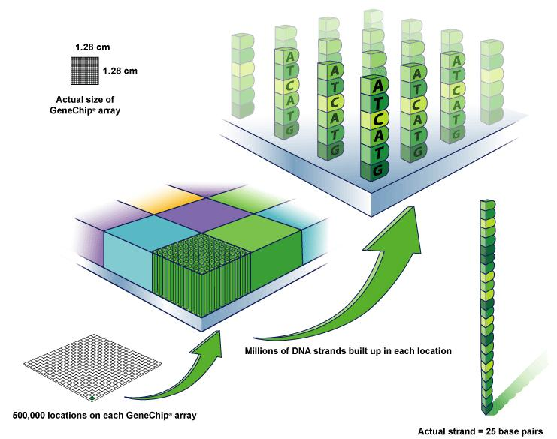
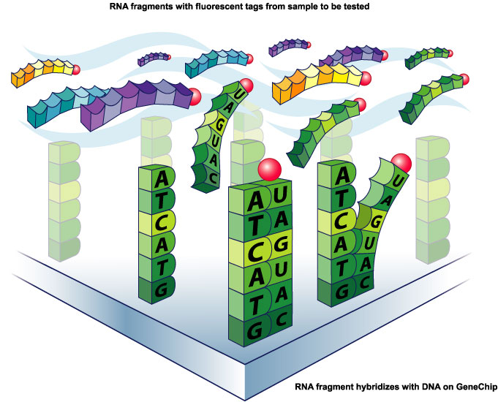
DNA Microarray
An Introduction to Bioinformatics Algorithms
www.bioalgorithms.info
Millions of DNA strands
build up on each location.
Tagged probes become hybridized to the DNA chip’s microarray.
‹#›
http://www.affymetrix.com/corporate/media/image_library/image_library_1.affx

Slide 35
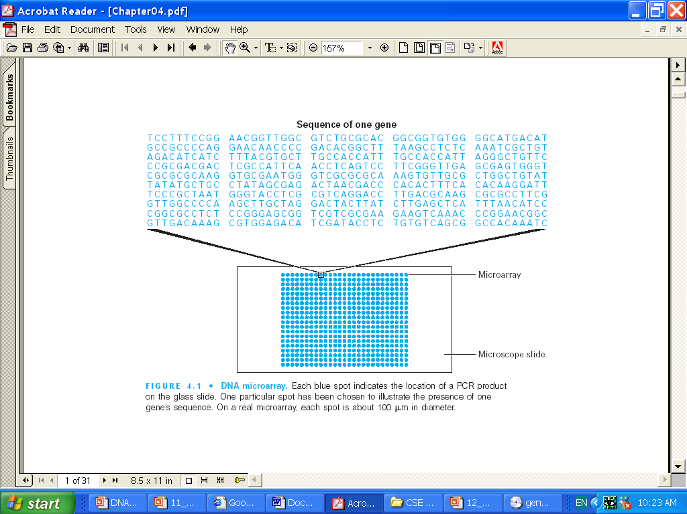
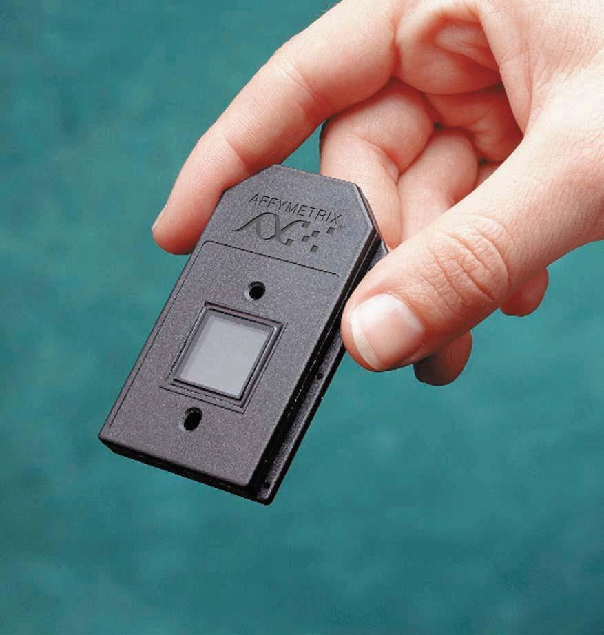
DNA Microarray
An Introduction to Bioinformatics Algorithms
www.bioalgorithms.info
Affymetrix
Microarray is a tool for analyzing gene expression that consists of a glass slide.
Each blue spot indicates the location of a PCR product. On a real microarray, each spot is about 100um in diameter.
www.geneticsplace.com
‹#›

Slide 36
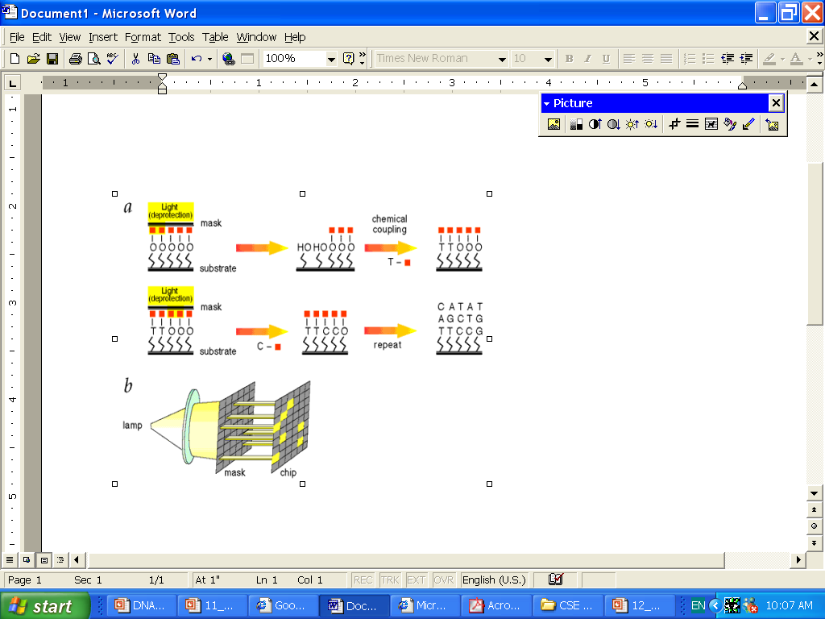
Photolithography
An Introduction to Bioinformatics Algorithms
www.bioalgorithms.info
Light directed oligonucleotide synthesis.
A solid support is derivatized with a covalent linker molecule terminated
with a photolabile protecting group.
Light is directed through a mask to deprotect and activate selected sites,
and protected nucleotides couple to the activated sites.
The process is repeated, activating different set of sites and coupling
different based allowing arbitrary DNA probes to be constructed at
each site.
‹#›

Slide 37
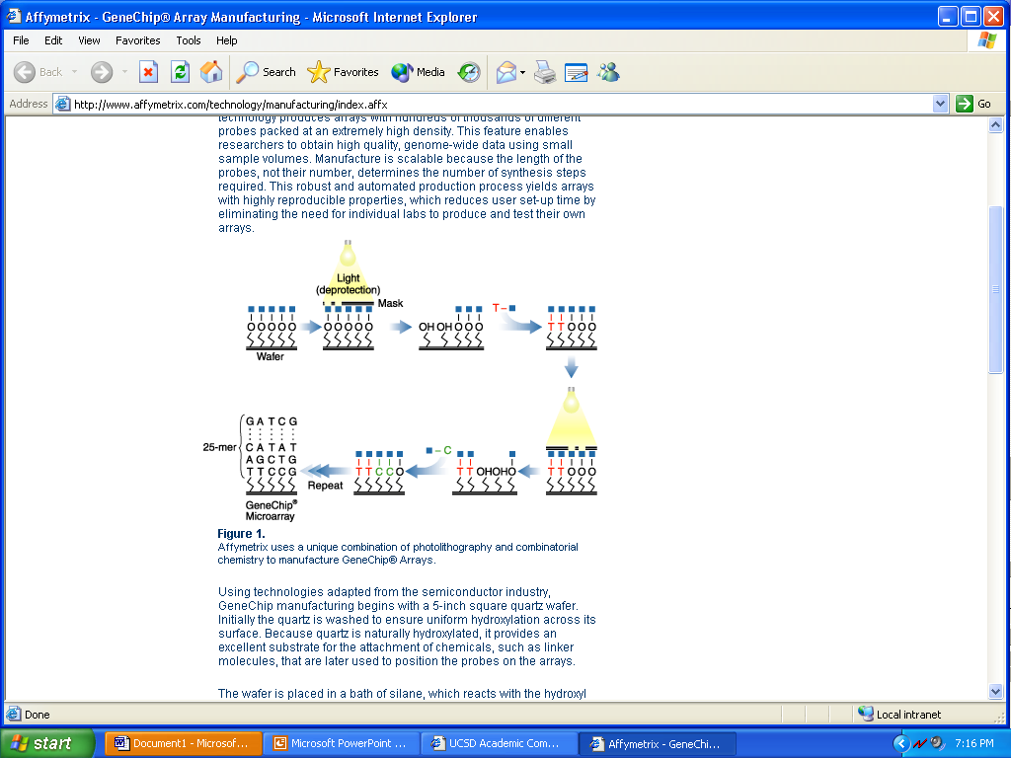
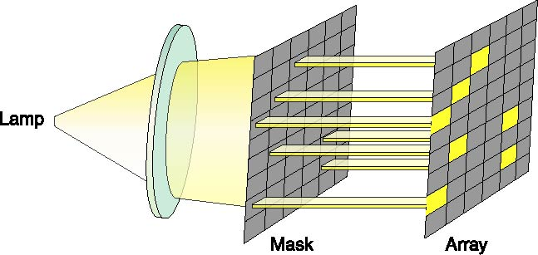
Affymetrix GeneChip® Arrays
A combination of photolithography and combinatorial chemistry to manufacture
GeneChip® Arrays. With a minimum number of steps, Affymetrix produces arrays with thousands of different probes packed at extremely high density. Enable to obtain high quality, genome-wide data using small sample volumes.
http://www.affymetrix.com/technology/manufacturing/index.affx
13

Slide 38
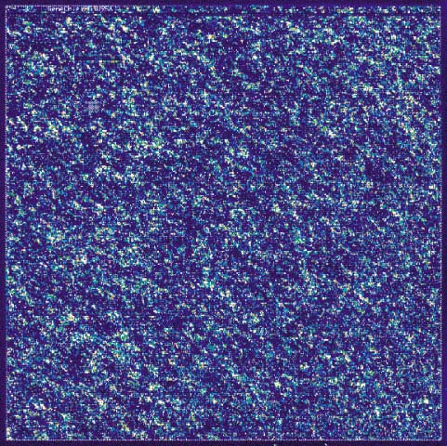
Affymetrix GeneChip® Arrays
Data from an experiment showing the
expression of thousands of genes on
a single GeneChip® probe array.
http://www.affymetrix.com/corporate/media/image_library/image_library_1.affx
14

